Slide 1
Quora Insincere Questions Classification
CS249 Advanced Seminar: Learning from Text – Spring 2019
Aashika Shetty
Kedar Deshpande
Shruti Sharan
Vidhu Malik

Slide 2
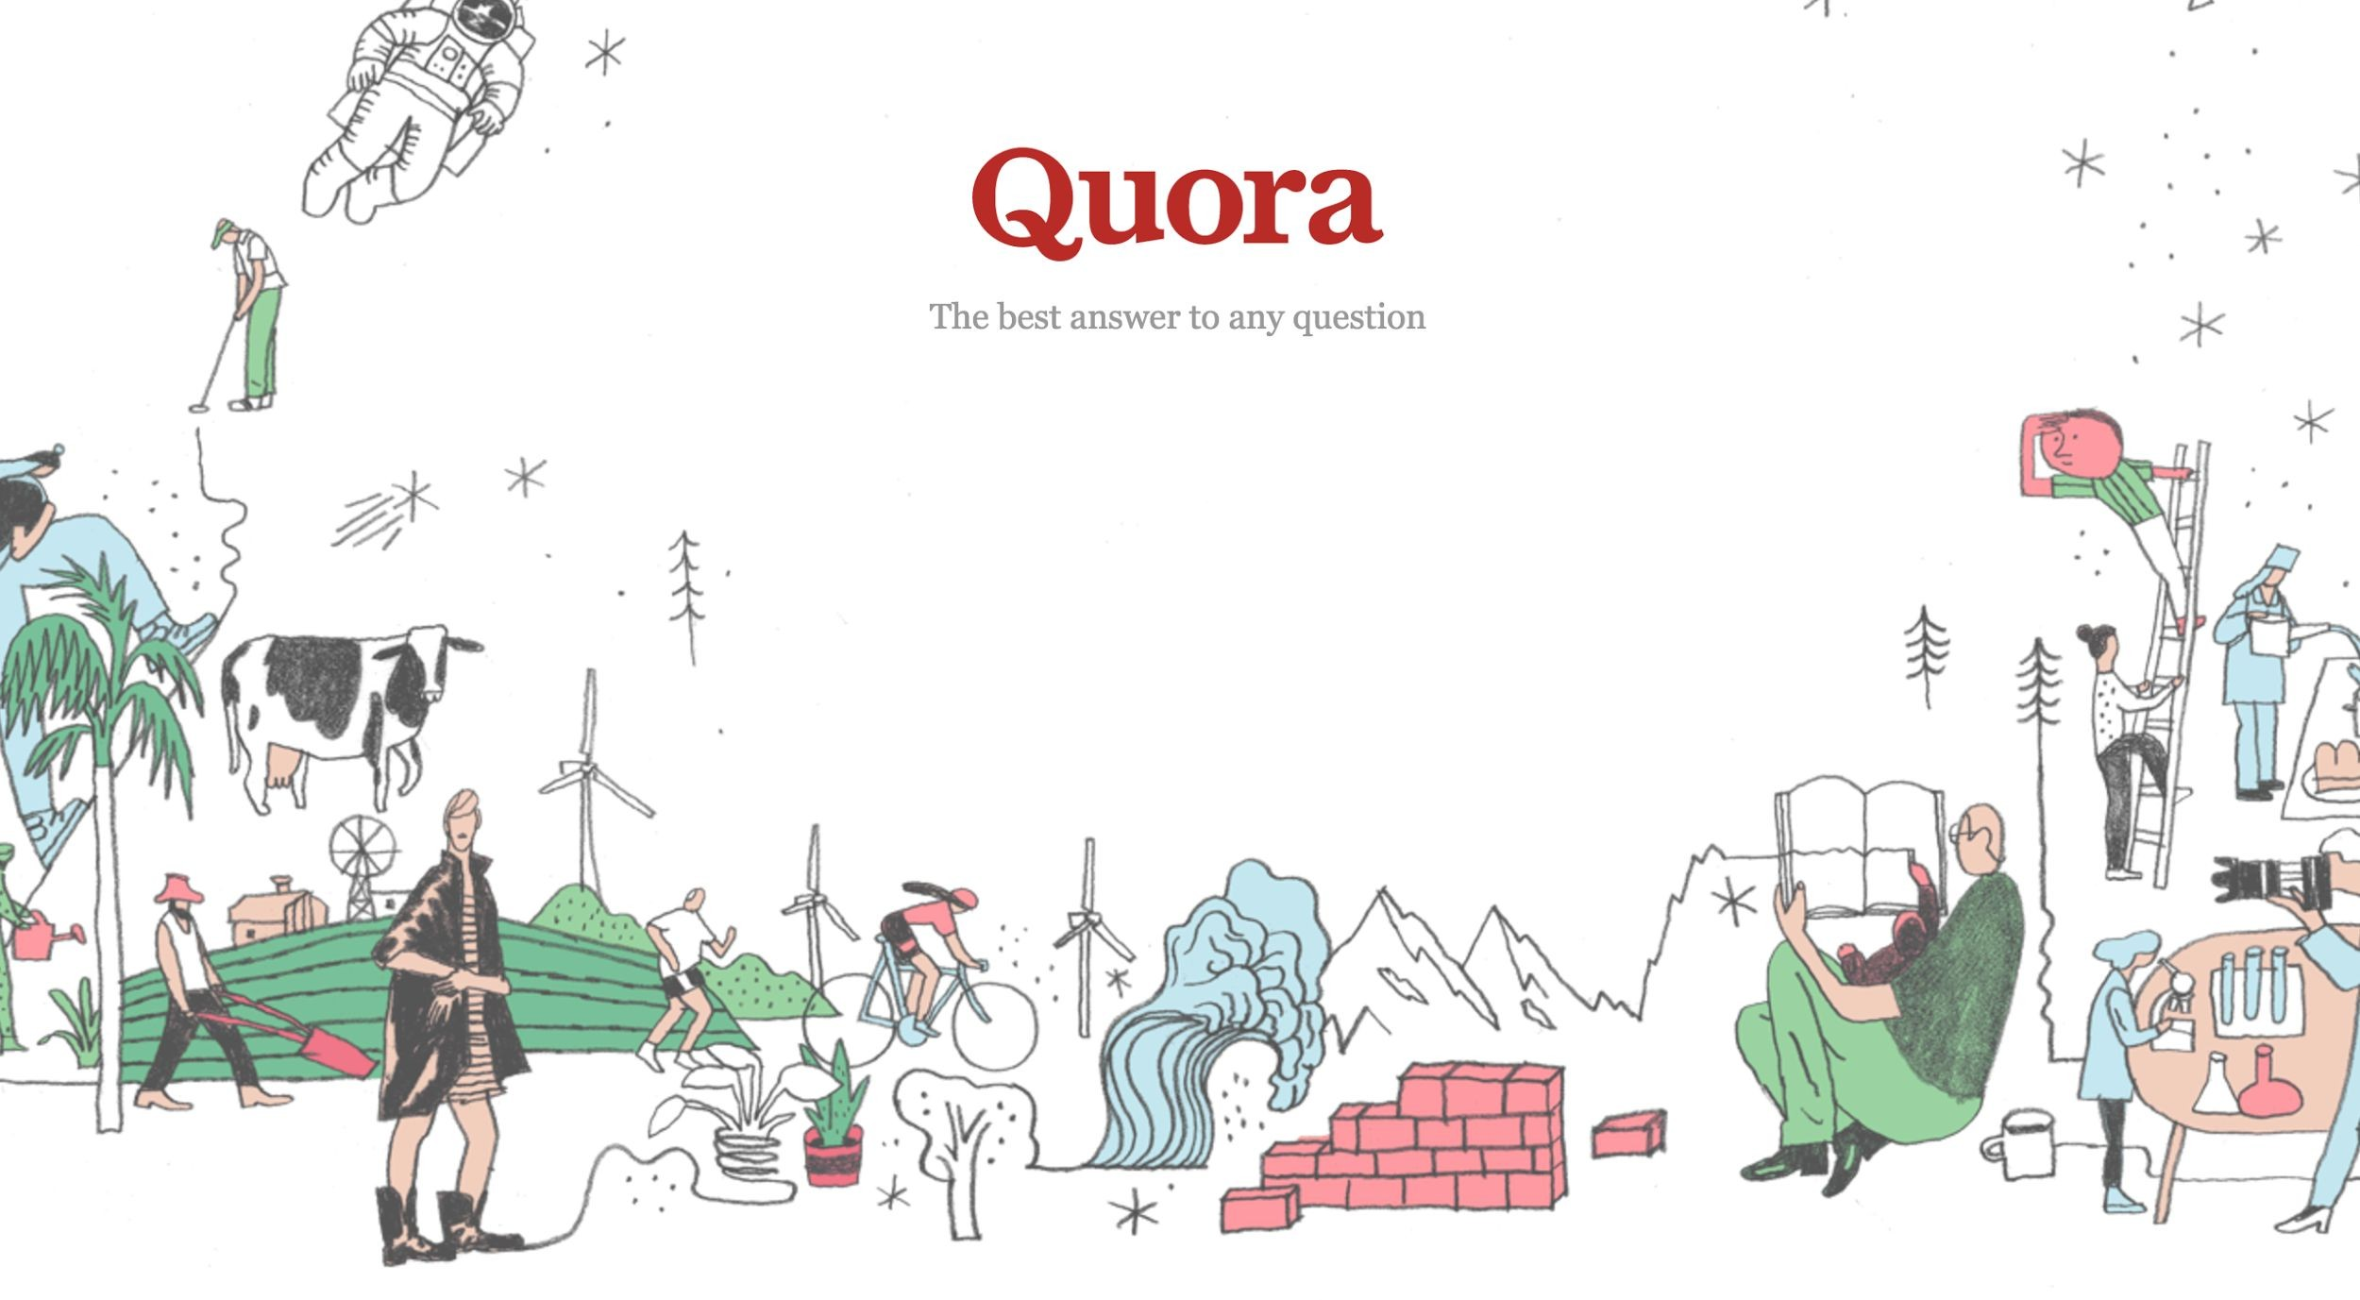

Slide 3

Problem Definition
To develop a system that can identify insincere questions present on Quora by developing models to detect toxic and misleading content
Notes:
On Quora, people can ask questions and connect with others who contribute unique insights and quality answers. A key challenge is to weed out insincere questions -- those founded upon false premises, or that intend to make a statement rather than look for helpful answers.
An existential problem for any major website today is how to handle toxic and divisive content. Quora wants to tackle this problem head-on to keep their platform a place where users can feel safe sharing their knowledge with the world.

Slide 4
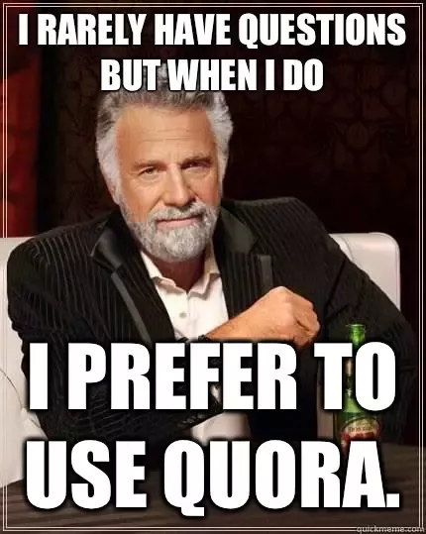
Motivation
Quora
190 million unique visitors
Over 100 million people visit Quora every month
Caters to different communities, age groups
Questioning and Answering
Questions seeking factual answers
Hypothetical questions
Experiences of people
Opinions or surveys on topics
Insincere questions (Rants, trolls, biased opinions)
Detection of insincere questions
Subjective
Similarity with sincere questions
Understanding the intent is a benchmark task in NLP

Slide 5
What is an insincere question?
Insincere question: A question intended to make a statement rather than look for helpful answers
Has a non-neutral tone
Is disparaging or inflammatory
Isn't grounded in reality
Uses sexual content for shock value, and not to seek genuine answers
Notes:
Has a non-neutral tone
Has an exaggerated tone to underscore a point about a group of people
Is rhetorical and meant to imply a statement about a group of people
Is disparaging or inflammatory
Suggests a discriminatory idea against a protected class of people, or seeks confirmation of a stereotype
Makes disparaging attacks/insults against a specific person or group of people
Based on an outlandish premise about a group of people
Disparages against a characteristic that is not fixable and not measurable
Isn't grounded in reality
Based on false information, or contains absurd assumptions
Uses sexual content for shock value, and not to seek genuine answers

Slide 6
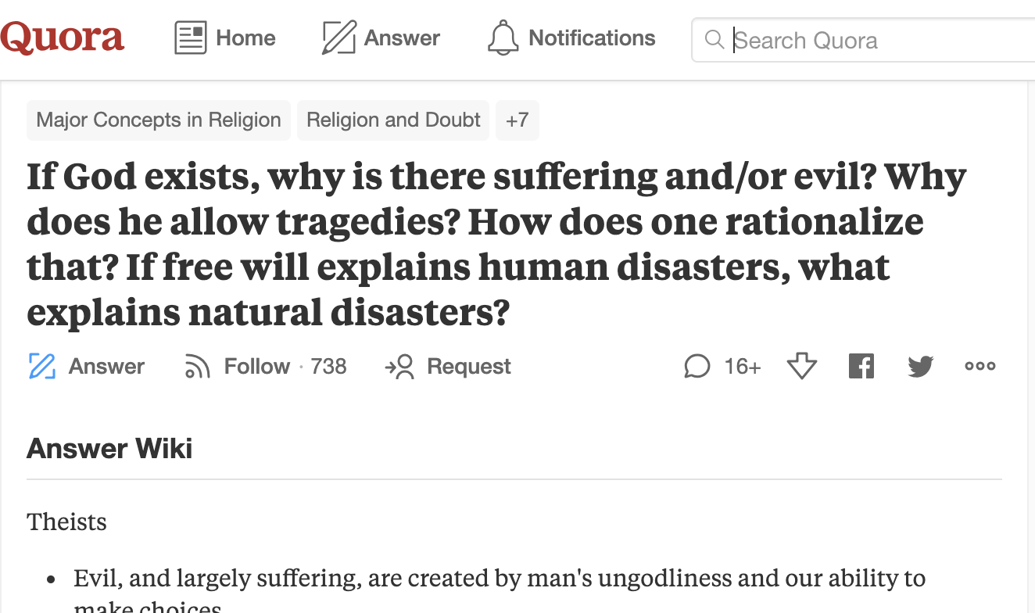

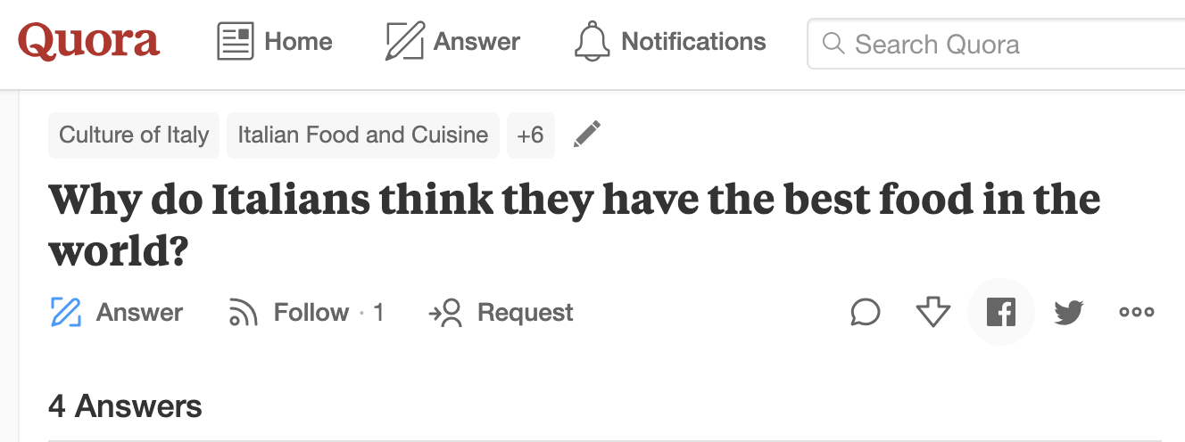
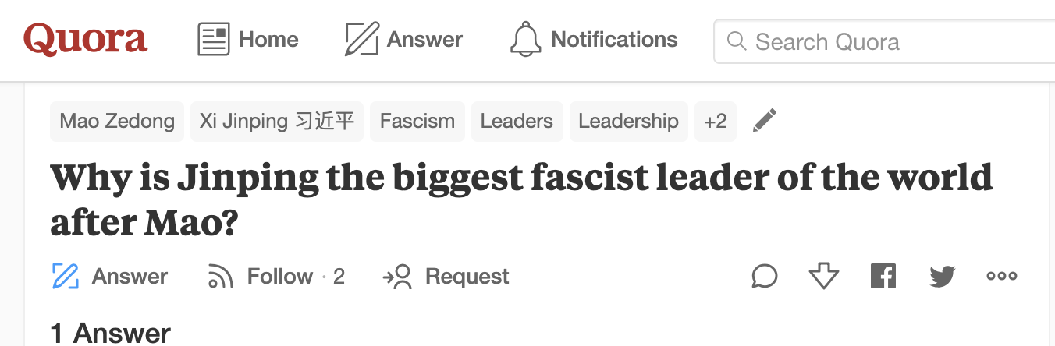
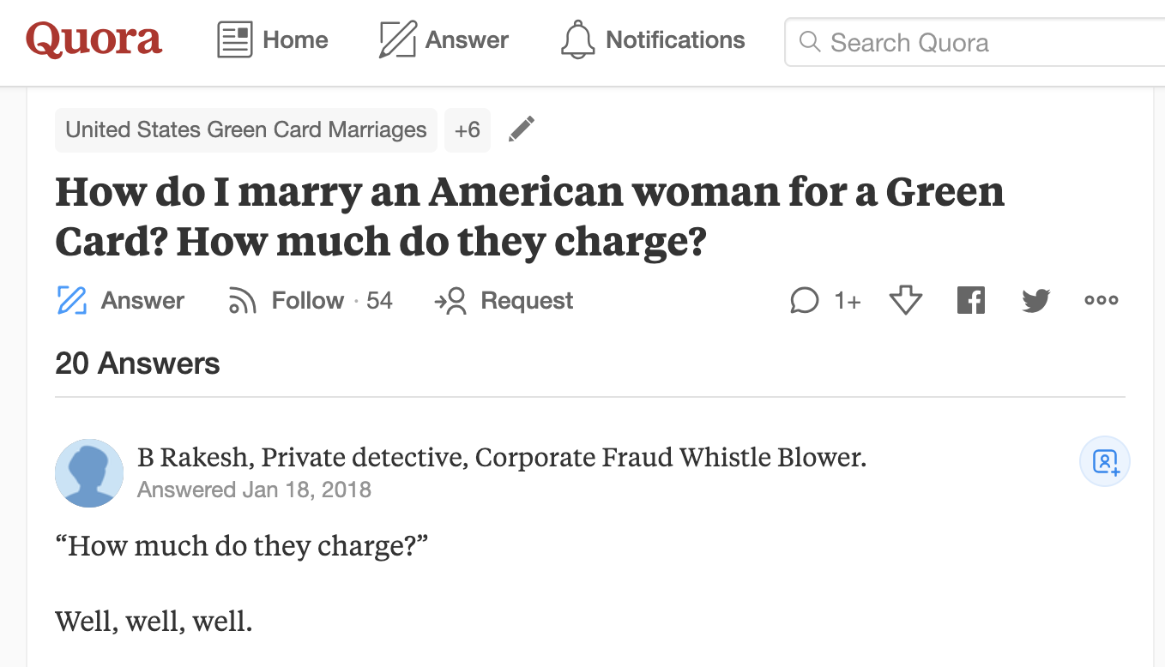
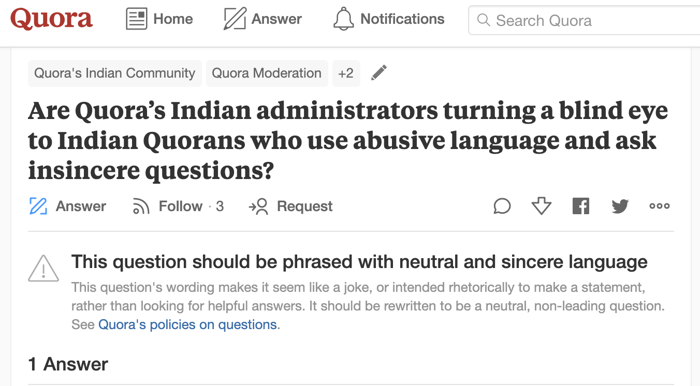
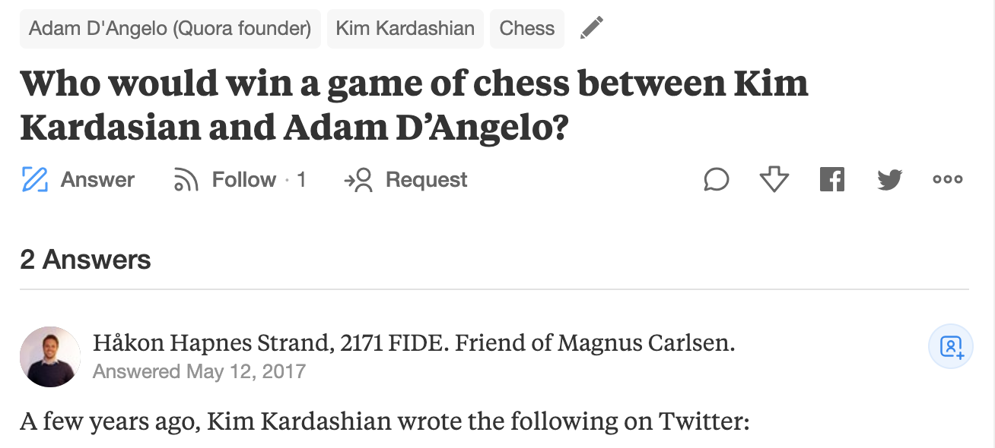
Examples of insincere questions

Slide 7
Dataset
Data fields
qid - unique question identifier
question_text - Quora question text
target - a question labeled "insincere" has a value of 1, otherwise 0
The training data includes:
the question that was asked
whether it was identified as insincere or not (Label = 1/0)

Slide 8
Dataset: Negative Examples
qid | question_text | target
00002165364db923c7e6 | How did Quebec nationalists see their province as a nation in the 1960s? | 0
000032939017120e6e44 | Do you have an adopted dog, how would you encourage people to adopt and not shop? | 0
0000412ca6e4628ce2cf | Why does velocity affect time? Does velocity affect space geometry? | 0
000042bf85aa498cd78e | Can I convert montra helicon D to a mountain bike by just changing the tyres? | 0

Slide 9
Dataset: Positive Examples
qid | question_text | target
0000e91571b60c2fb487 | Has the United States become the largest dictatorship in the world? | 1
00013ceca3f624b09f42 | Which babies are more sweeter to their parents? Dark skin babies or light skin babies? | 1
0004a7fcb2bf73076489 | If blacks support school choice and mandatory sentencing for criminals why don't they vote Republican? | 1
00052793eaa287aff1e1 | If both Honey Singh and Justin Bieber fall from the 5th floor, who will survive? | 1

Slide 10
Prior Art
Understanding the architectures proposed in the top solutions of the challenge
Identifying the distinguishing elements and important design decisions proposed
Some interesting solutions and their design choices:
Data Driven approach involving combination of upto 3 embeddings
Preprocessing heavy architectures involving extensive cleaning
Usage of attention mechanisms
Usage of Projection Meta Embedding and Exponential moving Average
Random Sampling in addition to Max Pooling
Bucketing and checkpoint ensembling
RNNs vs CNN models
Common choice: Importance of cross validation
Notes:
Our aim is to use the important components from several models and use a combination of these elements
Mention all various cleaning techniques

Slide 11
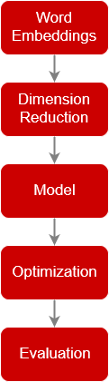
Possible Approach
Data Preprocessing
Word embeddings
Dimension reduction
Core Architecture:
Vanilla RNN
Use of Single Bi-LSTM
Convolution layers
Bi-GRU
FC Net
Model Optimisation
Evaluation
Notes:
Standard techniques: spell check, removal of stop words, to lower case, stemming and lemmetization etc
word embeddings: word2vec, glove, paragram, elmo, bert
Model Optimisation: cross validation, batch normalisation, dropout, hyper parameter tuning
DImension reduction: Spacial dropout, Maxpooling, importance sampling, PCAd

Slide 12
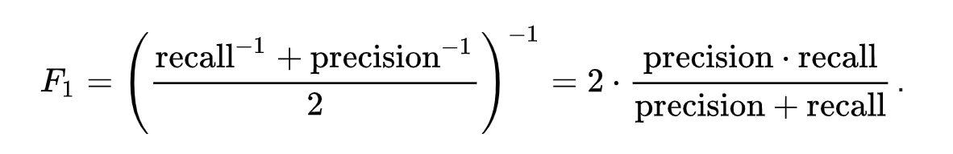
Evaluation
In the statistical analysis of binary textual classification, F₁ score is a measure of a test's accuracy.
It considers both the precision p and the recall r of the test to compute the score:
Also used as the metric for the Kaggle challenge.
Notes:
Recall
Precision

Slide 13
Questions?

